Slide 1
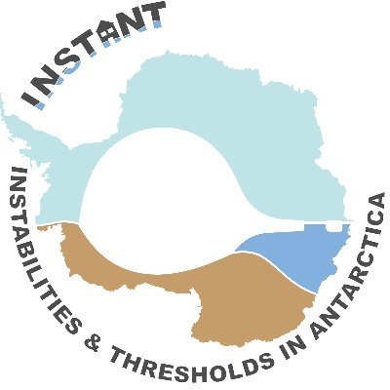
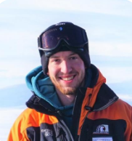
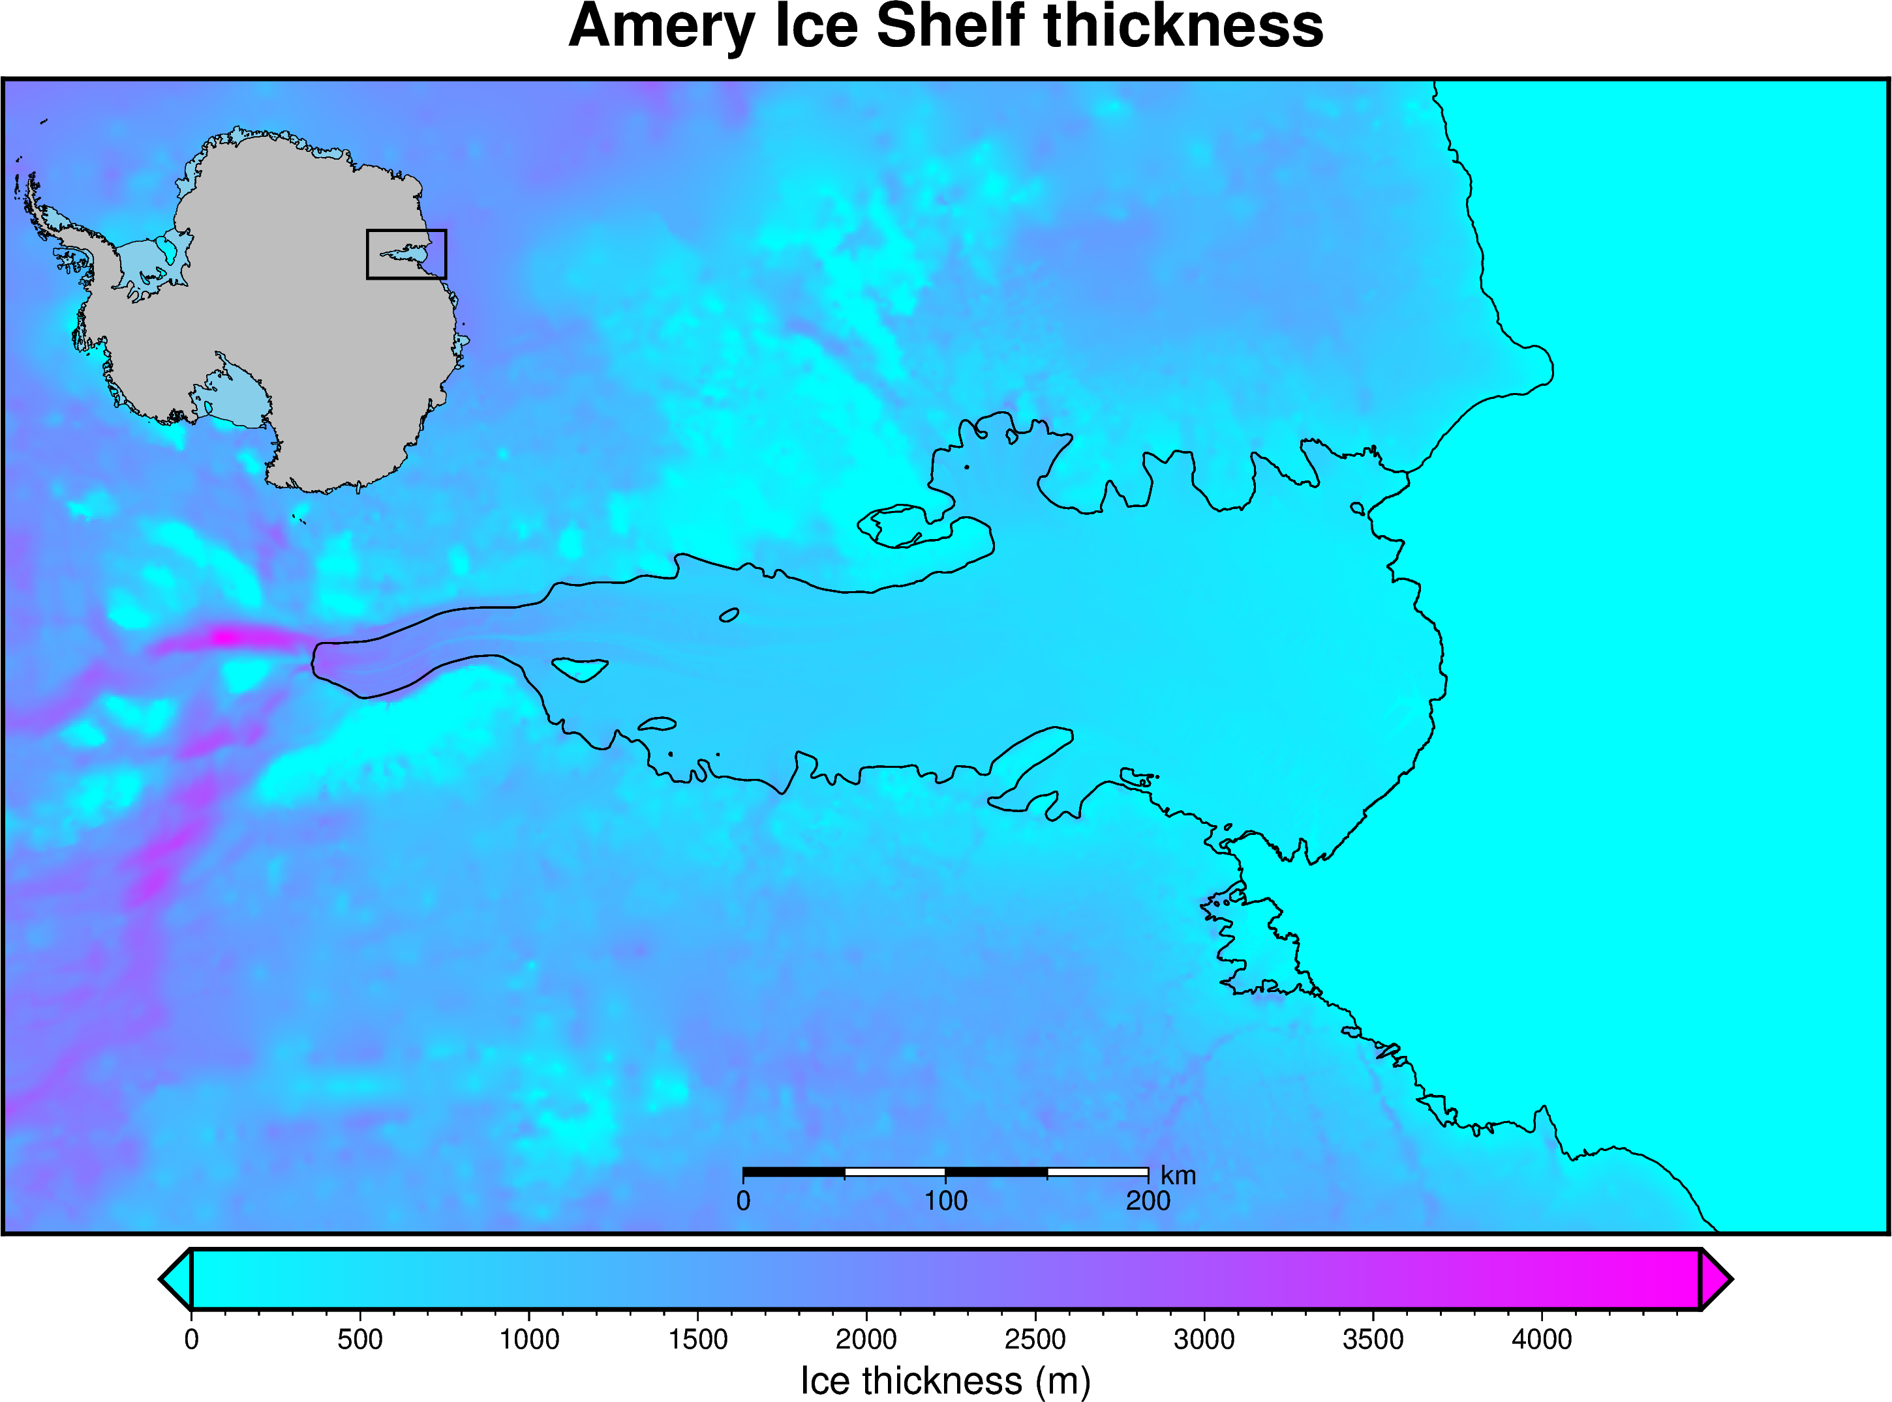
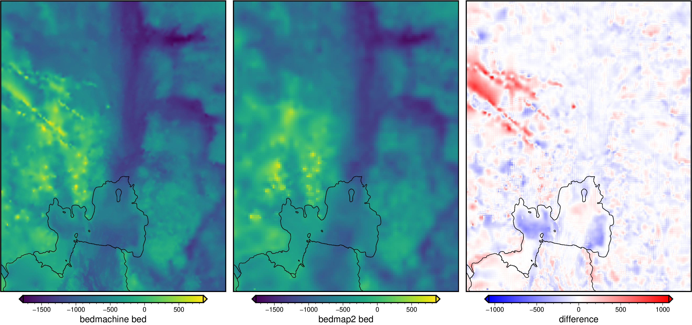
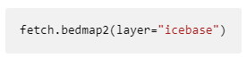
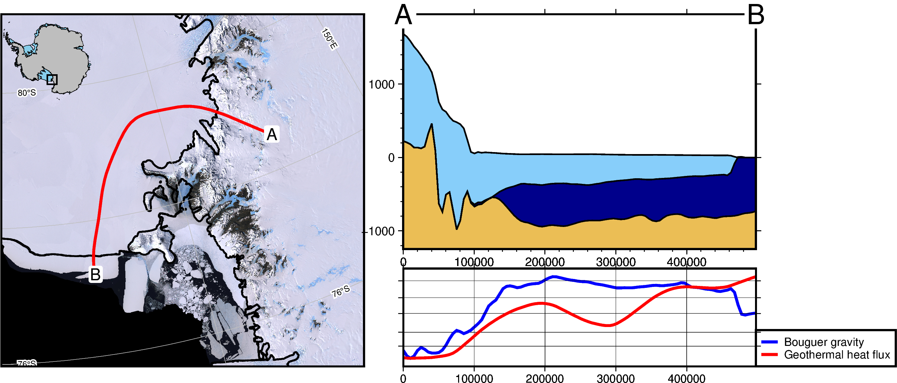
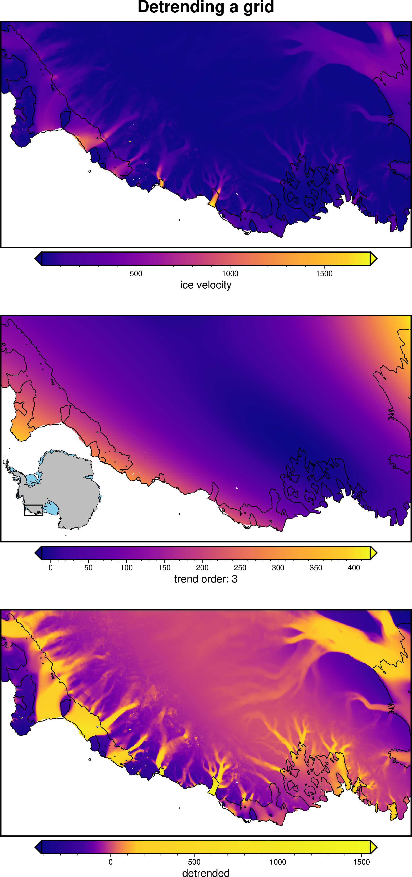
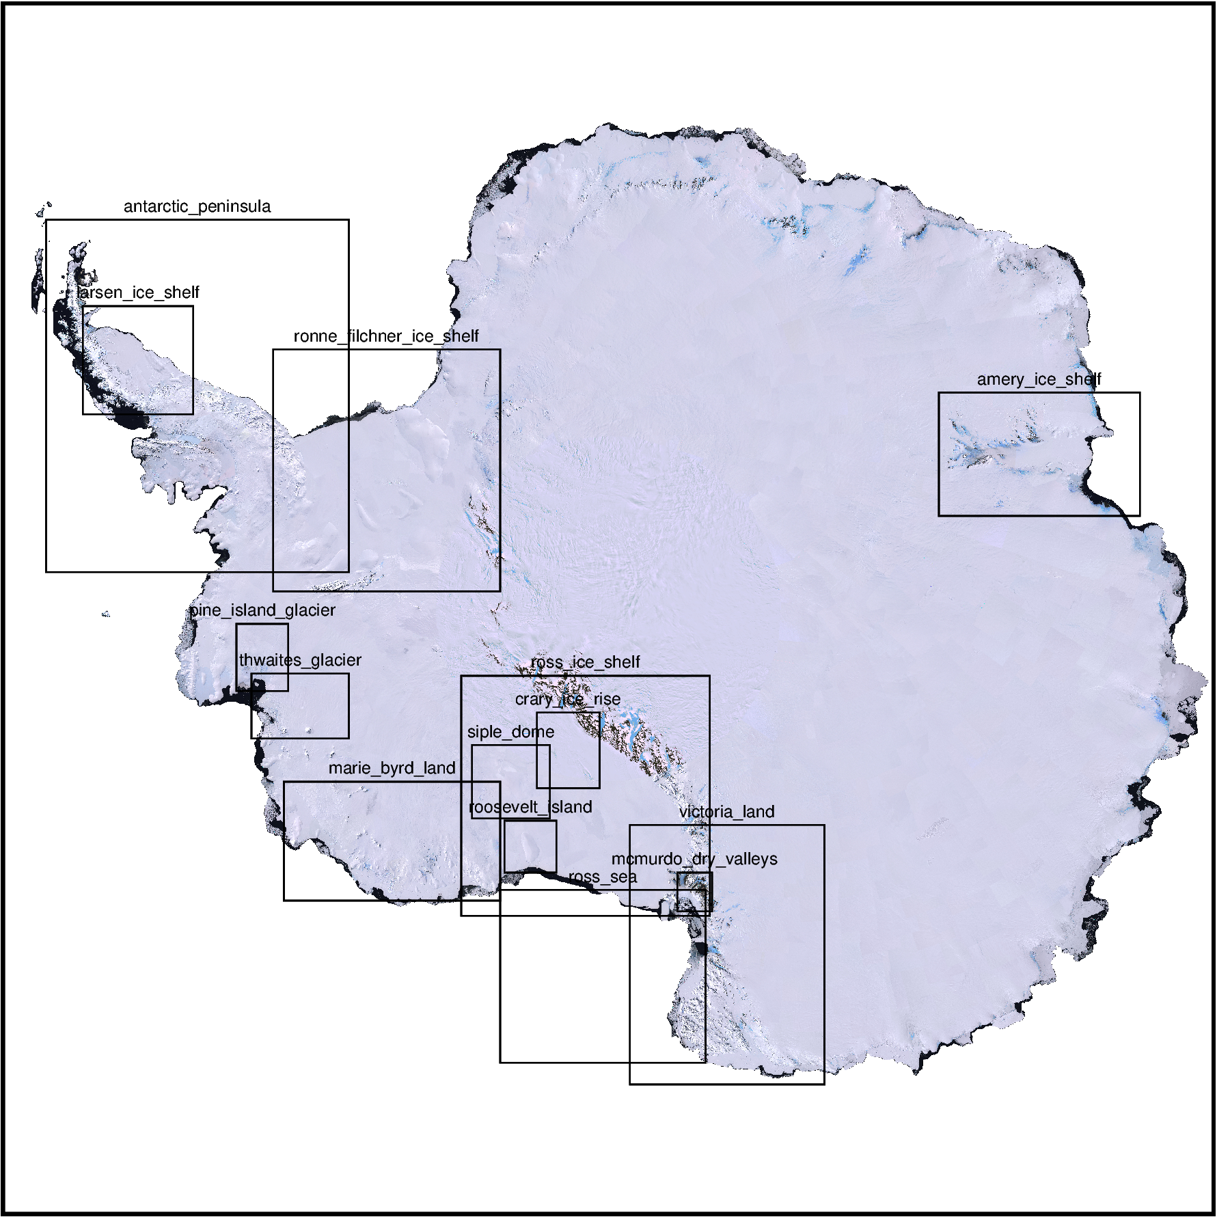
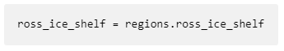







Antarctic-Plots
A Python package to help download, visualize, and present Antarctic datasets
Introduction
Antarctic-Plots is a new Python package developed to help with conducting Antarctic science. The 5 modules shown here provide tools to help with a variety of uses.
from antarctic_plots import maps
easily create high-quality maps (uses PyGMT in the background)
use independently or use it as an extension to PyGMT
from antarctic_plots import utils
useful functions for general geoscience applications
ex. compare two grids, fit a trend to a grid, mask grids based on shapefiles, various coordinate conversions
from antarctic_plots import fetch
download, store and retrieve datasets
no need to remember file paths
enables reproducible and shareable code
easy to add more datasets!
# download
ice_thickness = fetch.bedmachine(
layer = "thickness",
region = regions.amery_ice_shelf,
spacing = 1000)
# plot
fig = maps.plot_grd(
grid = ice_thickness,
cmap = "cool",
coast = True,
title = "Amery Ice Shelf thickness",
cbar_label = "Ice thickness (m)",
inset = True,
scalebar = True)
fig.show()
# define a region
region = regions.pine_island_glacier
# download
bedmachine = fetch.bedmachine("bed", spacing=1e3, region=region)
bedmap = fetch.bedmap2("bed", spacing=1e3, region=region)
# compare
dif, grid1, grid2 = utils.grd_compare(bedmachine, bedmap,
plot=True, grid1_name="bedmachine bed", grid2_name="bedmap2 bed")
Bedmachine
Bedmap2
DeepBedMap
Geothermal heat flux
Gravity
Magnetics
Grounding line
Coastline
Satellite imagery
Ice velocity
from antarctic_plots import profile
sample of datasets along lines
plot cross sections and profiles
3 methods of defining a profile line:
straight line between 2 points
shapefile
interactively draw a line
from antarctic_plots import regions
helps with defining geographic regions
pre-set regions for common areas
custom regions from an interactive map
# download
ice_velocity = fetch.ice_vel(
region=regions.marie_byrd_land,
spacing=1e3)
# extract and detrend
fit, detrend = utils.grd_trend(
ice_velocity, deg=3)
# plot
fig = maps.plot_grd(detrend,
fig_height=10, cmap='plasma',
grd2cpt=True, coast=True,
cbar_label='detrended')
fig = maps.plot_grd(fit, fig=fig,
fig_height=10, cmap='plasma',
grd2cpt=True, coast=True,
cbar_label='trend order: 3',
inset=True, inset_pos='BL',
origin_shift='yshift')
fig = maps.plot_grd(ice_velocity,
fig=fig,
fig_height=10, cmap='plasma',
grd2cpt=True, coast=True,
cbar_label='ice velocity',
title="Detrending a grid",
origin_shift='yshift')
fig.show()
# download
gravity = fetch.gravity('BA')
GHF = fetch.geothermal('losing-ebbing-2021')
# set properties
data = profile.make_data_dict(
["Bouguer gravity",
"Geothermal heat flux"],
[gravity, GHF],
["blue", "red"])
# draw profile location
lines = maps.draw_lines()
line = utils.shapes_to_df(lines)
# plot
profile.plot_profile(
method = "polyline",
polyline = line,
num = 100,
data_dict = data,
add_map = True)
Try it on your phone:
Open a Binder environment
https://bndr.it/b5dn7
Download the poster:
https://doi.org/jds4
matt.d.tankersley@gmail.com
http://antarctic-plots.rtfd.io/
https://github.com/mdtanker/antarctic_plots
Matthew Tankersley^{1,2}
¹Antarctic Research Centre, Victoria University of Wellington, NZ
²GNS Science
Notes:
1 min intro:
30 sec run through:

